Slide 1
Data Engineering with GCP
Cloud sql & Cloud spanner

Slide 2
Revision History
Version | Date | Author | Reviewed by | Comments
1.0 | 15-Oct-2024 | Poorva Kulkarni |  | Initial Version

Slide 3
Understanding cloud SQL
Creating cloud SQL instances
Replication and data management
Understanding cloud spanner
Creating cloud spanner instances

Slide 4

Introduction to Cloud SQL

Slide 5
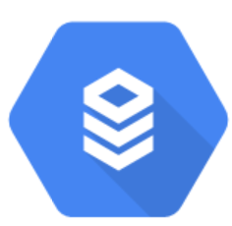
Databases that fits your need
Relational: Cloud SQL
Managed MySQL, PostgreSQL, and SQL Server
Use case:
ERP
CRM
Ecommerce and web
SaaS application

Slide 6
Cloud SQL
Relational database on GCP
Fully-managed database service
Aids in relational databases administration, management and setup.
Cloud SQL can be used with SQL Server, PostgreSQL, or MySQL

Slide 7
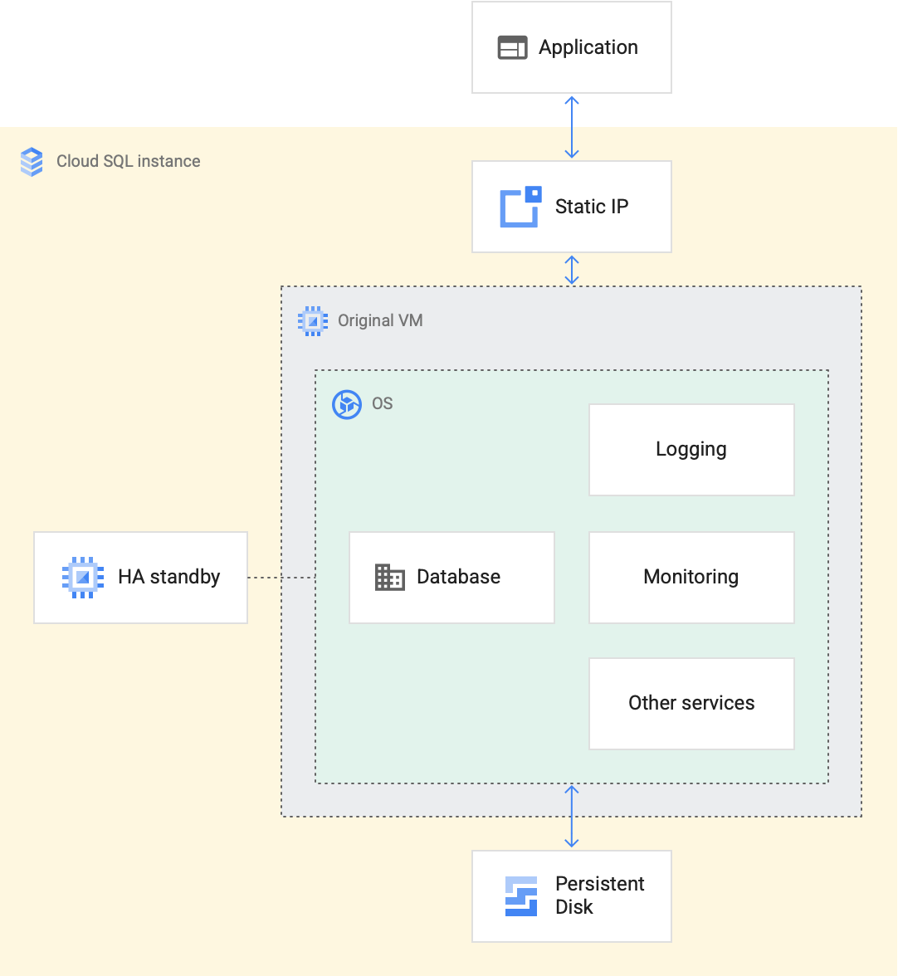
Cloud SQL instance
What is a cloud SQL instance?
Virtual machines (vms) running on google cloud servers power each cloud SQL instance. The database program, such as mysql server, postgresql, or SQL server, is run by each virtual machine.

Slide 8
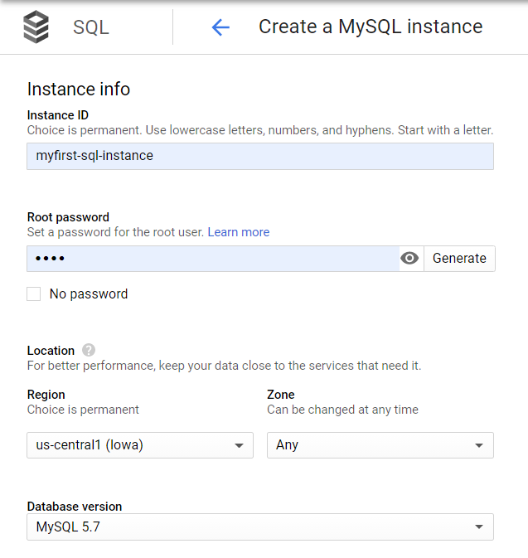
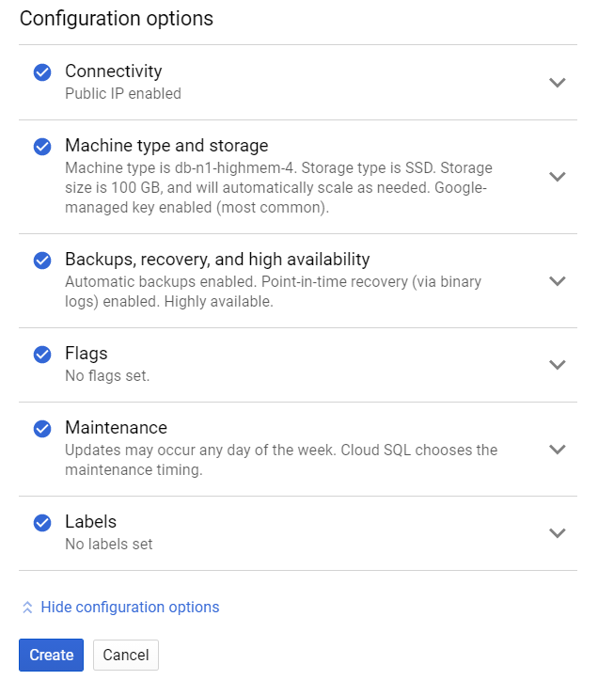
Cloud SQL for MySQL

Slide 9
Understanding Cloud SQL in GCP Service
Using mysql on cloudsql
Fully managed cloud-based MySQL community edition databases
Custom machine types with 96 CPU’s and up to 624 GB of RAM
With the option to automatically expand storage capacity as needed, up to 64TB of storage is available
Using PostgreSQL on CloudSQL
PostgreSQL 9.6 version with second generation instances
It Provides 10 TB of storage
.

Slide 10
Pricing for both mysql and postgresql is calculated as
Total Price=InstancePrice + StoragePrice + NetworkPrice
Price=InstancePrice + StoragePrice + NetworkPrice
Instance Price- pay for VM’s where we are running MySQL instances
Storage Price-pay for the persistent disk, depends on whether we choose SSD or HDD
Network Price-Ingress will be free, (within GCP),Egress price is applied(usually applied as network charge)

Slide 11
Cloud Spanner

Slide 12
Databases that fit your needs
Relational: Cloud Spanner
Cloud-native with unlimited scale, consistency, and 99.999% availability
Use case:
Gaming applications
Financial ledger
Inventory Supply chain management

Slide 13
Understanding Cloud Spanner
Nodes and Instances :
Two crucial decisions are made during instance creation: the compute capacity and the instance settings.
The placement and quantity of the instance's serving and storage resources are determined by these selections.
An instance must be set up as either regional or multi-regional when it is created.
An instance's compute capacity is specified when it is created as a number of nodes or processing units, with 1000 processing units equivalent to one node.

Slide 14
Continued..
Configurations at the regional level
Three read-write copies are maintained by spanner for any basic regional setup, each located in a distinct Google Cloud zone inside that area.
A complete copy of your operational database that can handle both read-write and read-only requests is included in each read-write replica.
Multiregional arrangements
As specified by the instance configuration, multi-region configurations enable you to duplicate the database's data not just in various zones but also in different zones across multiple regions.
You can read data from several sites near or inside the regions in the configuration with minimal latency thanks to these extra replicas.

Slide 15
Continued..
Limits on data storage
The following rules are used by spanner to determine storage limitations based on an instance's computing capacity in order to offer high availability and low latency while accessing a database:
For instances with fewer than 1000 processing units (one node), spanner allocates 409.6 GB of data for each 100 database processing units.
The spanner allocates 4 tb of data per node for instances with 1 node or more.

Slide 16
Continued..
Schema
A collection of logically arranged database objects is called a schema.
These could be stored procedures, tables, views, or anything else.
In a database, schemas are usually used to group things logically.
Model of data
In a database, a relational data model is one that is described by tables.
The data explains the organization and storage of the data.
Although a data model may be a part of multiple schemas, it usually only belongs to one.

Slide 17
Continued..
Replication
Spanner automatically replicates at the byte level
Spanner creates replicas of each database split
Spanner has three types of replicas: read-write replicas, read-only replicas, and witness replicas.
Benefits of replication
Data availability
Geographic locality
Single database experience
Easier application development

Slide 18
Continued..
Pricing
When you use spanner, you are charged for the following
The amount of compute capacity in your instance.
The amount of storage that your databases use.
The amount of storage that your backups use.
The amount of network bandwidth used.

Slide 19
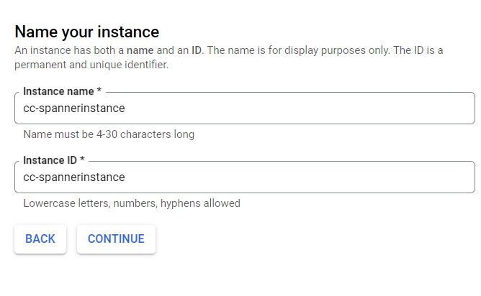
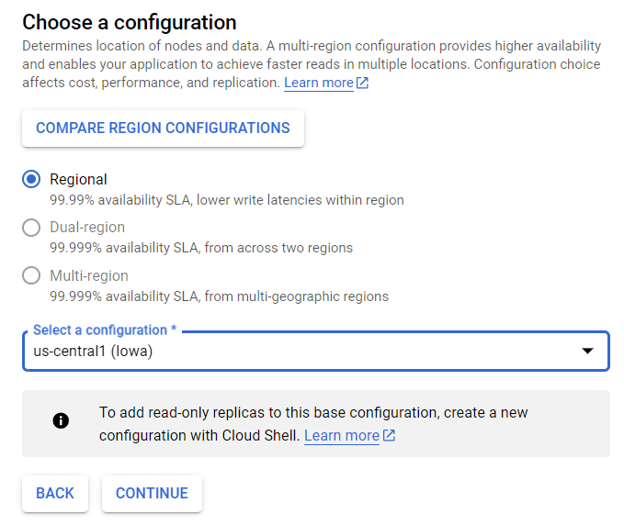
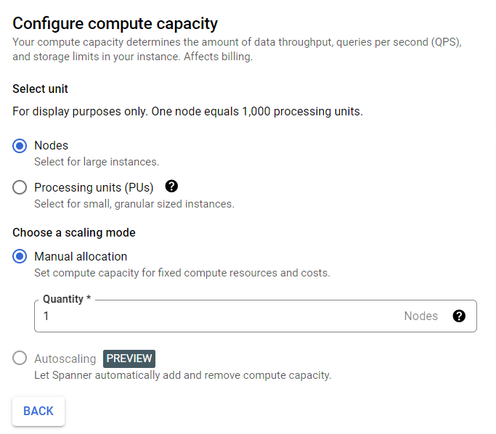
Cloud Spanner Instance

Slide 20
Create Cloud SQL instances
Set replica settings
Create Cloud Spanner instances
Differentiate Cloud SQL and Cloud Spanner

Slide 21
Thank You

